Slide 1


Stroke free?
Stress free.
By: Jaskirat, Jelena, Nicole & Yumai (Team 5)

Slide 2


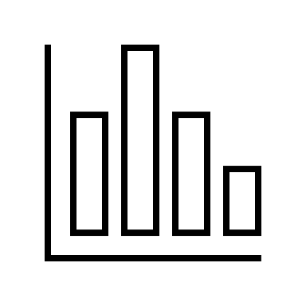

Agenda
Introduction
DEMOGRAPHICS
Sub-Question 1
CONCLUSION
Interactive Dashboard
Jaskirat
Jelena
Project 3:
Team 5
Nicole
Yumai
LIFESTYLE
CHOICES
Sub-Question 2
Analysis Approach
Visualization
BIOLOGICAL PREDICTORS
Sub-Question 3

Slide 3

WORLD STROKE Organization projects a 50% rise in a stroke that will claim 9.7 million lives a year by 2050
Globally, 1 in 4 adults, over the age of 25 will have a stroke in their lifetime.
STROKE PREDICTORS Problem Statement:
How can patients of higher stroke risk be more easily identified through measurable, and potentially modifiable, metrics in lifestyle and health status?

Slide 4
Data Source: The healthcare-dataset- stroke-data.csv from Kaggle.com
The dataset includes various features related to patients’ health and lifestyle, including age, gender, hypertension, heart disease, marital status, work type, residence type, average glucose level, BMI, smoking status, stroke.
There are 5,110 patients in this dataset
Libraries used: Pandas, Nympy, MatPlotLib, JSON, Flask, Sqlite, SQLAlchemy, Plotly, D3, HighChart
Languages used: Python, SQL, JavaScript, HTML, CSS

Slide 5
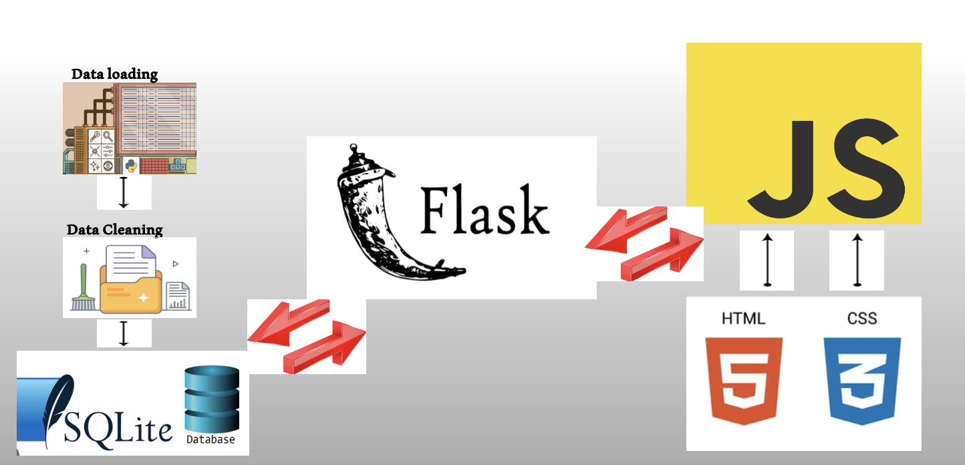
WORKFLOW DIAGRAM

Slide 6
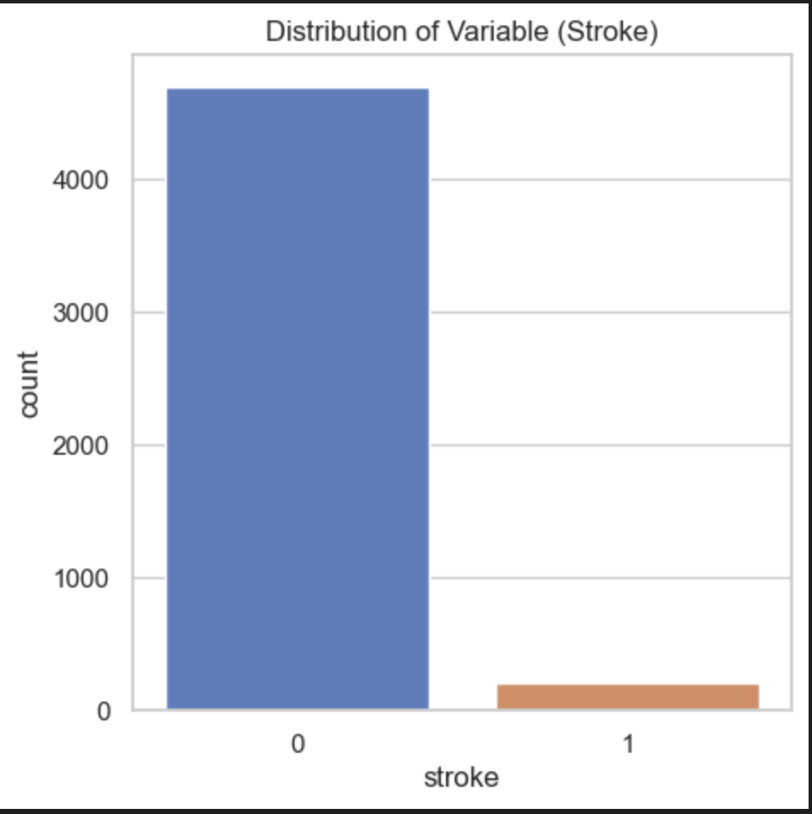
Variable stroke
Highly imbalanced
In this dataset there is total of 209 strokes out of 4,908 patients.
a lot more instances of no stroke 0 than stroke 1

Slide 7
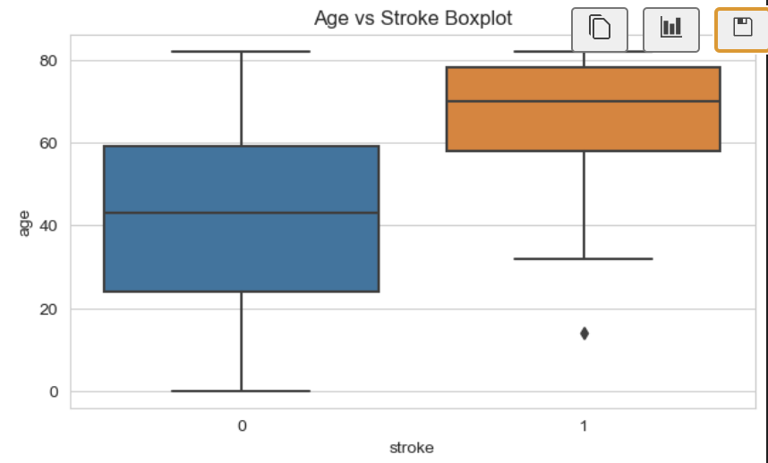
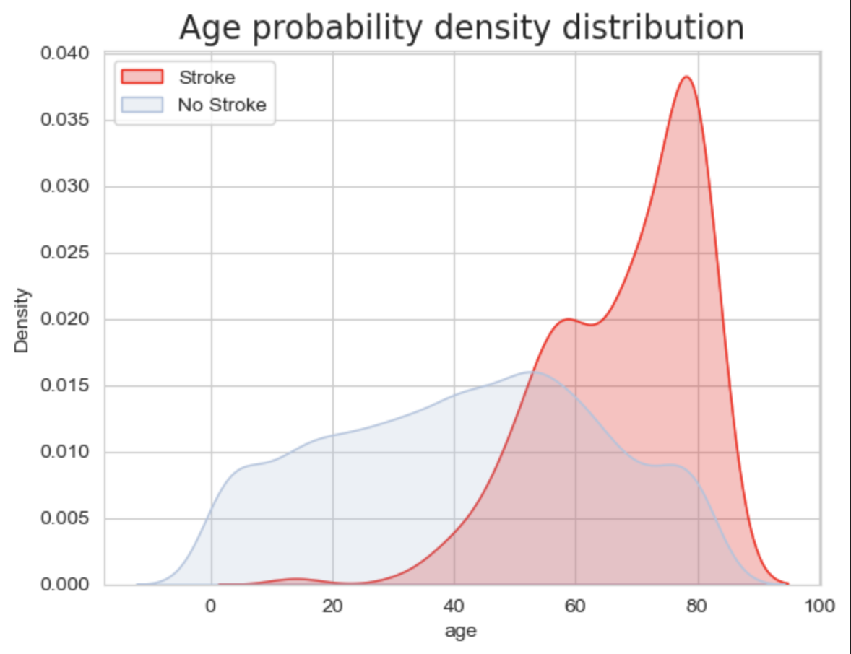
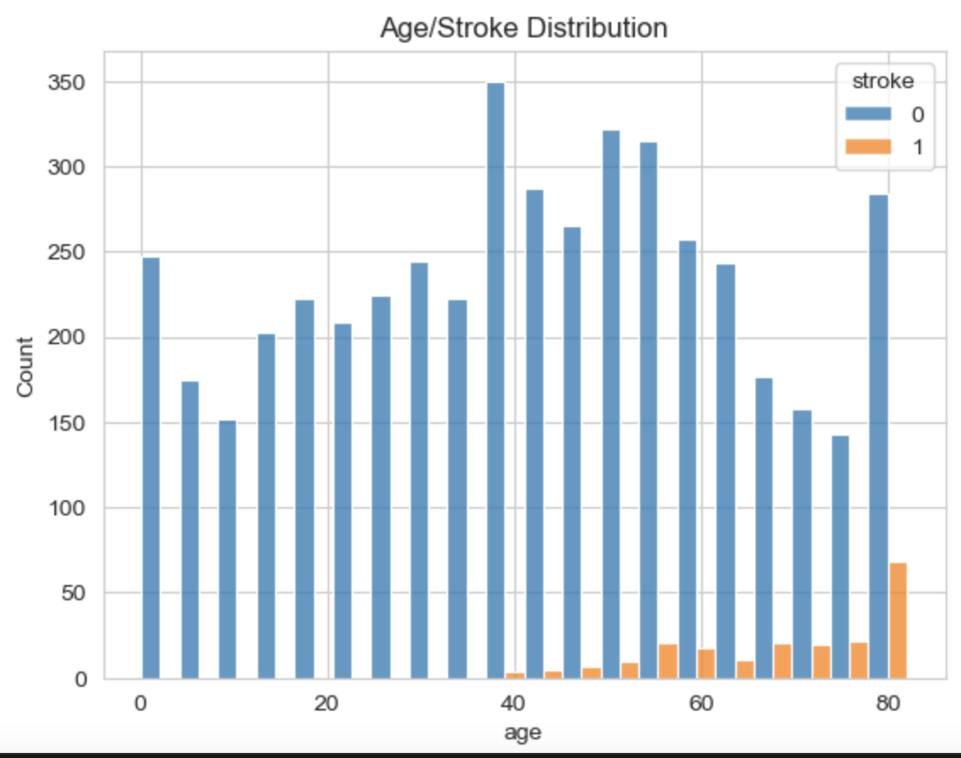
Age versus Stroke
The age of patients varies but majority of them are in the range of 40-80.
Stroke cases are more common in older patients. The median age of stroke patients appears to be higher than of non-stroke patients.
Aging has been identified to be the most robust non-modifiable risk factor for stroke, which doubles the risk every 10 years after 55 years.

Slide 8
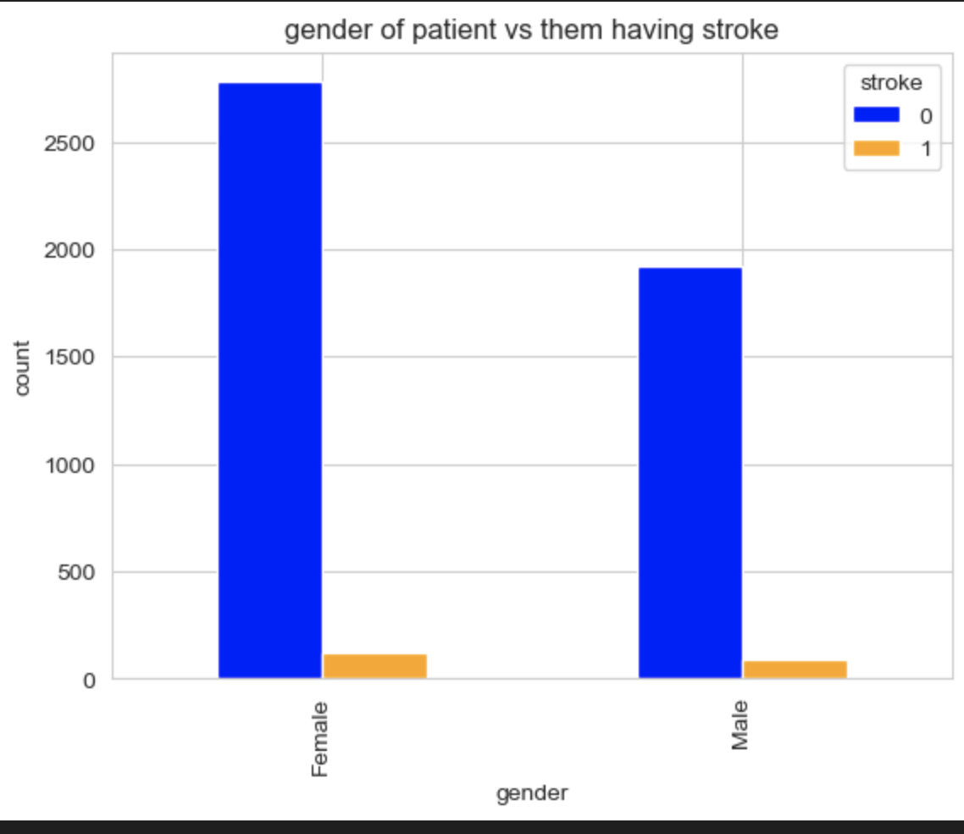
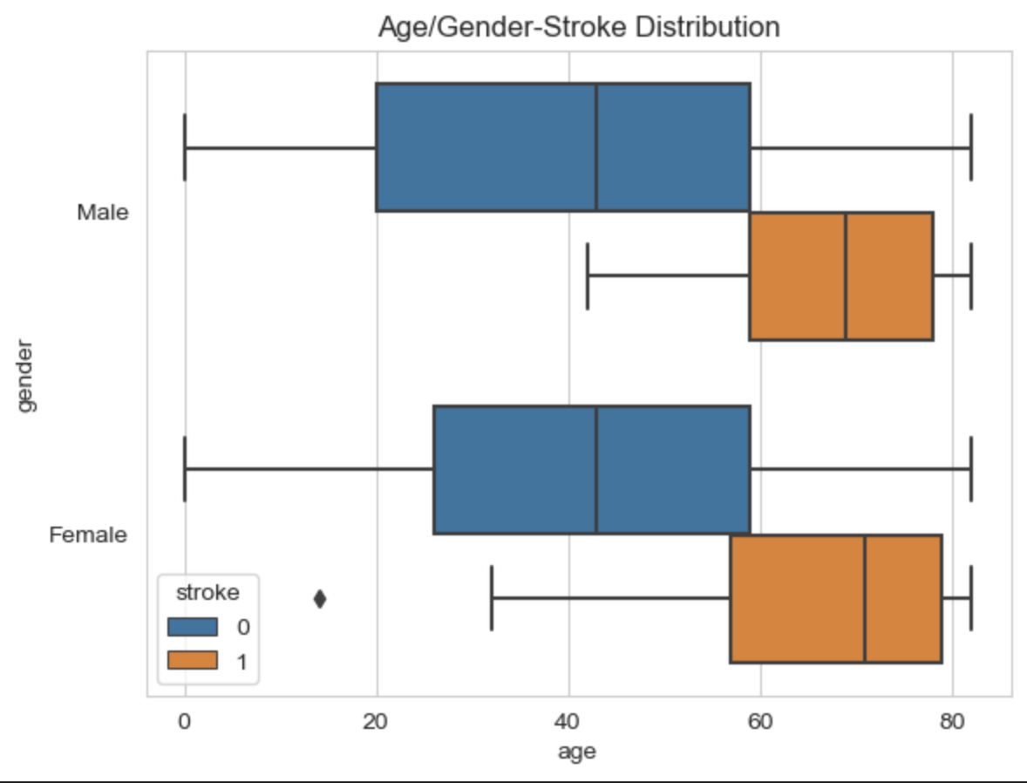
Gender vs. stroke
Both females and males have similar proportion of stroke cases with males having slightly more.

Slide 9
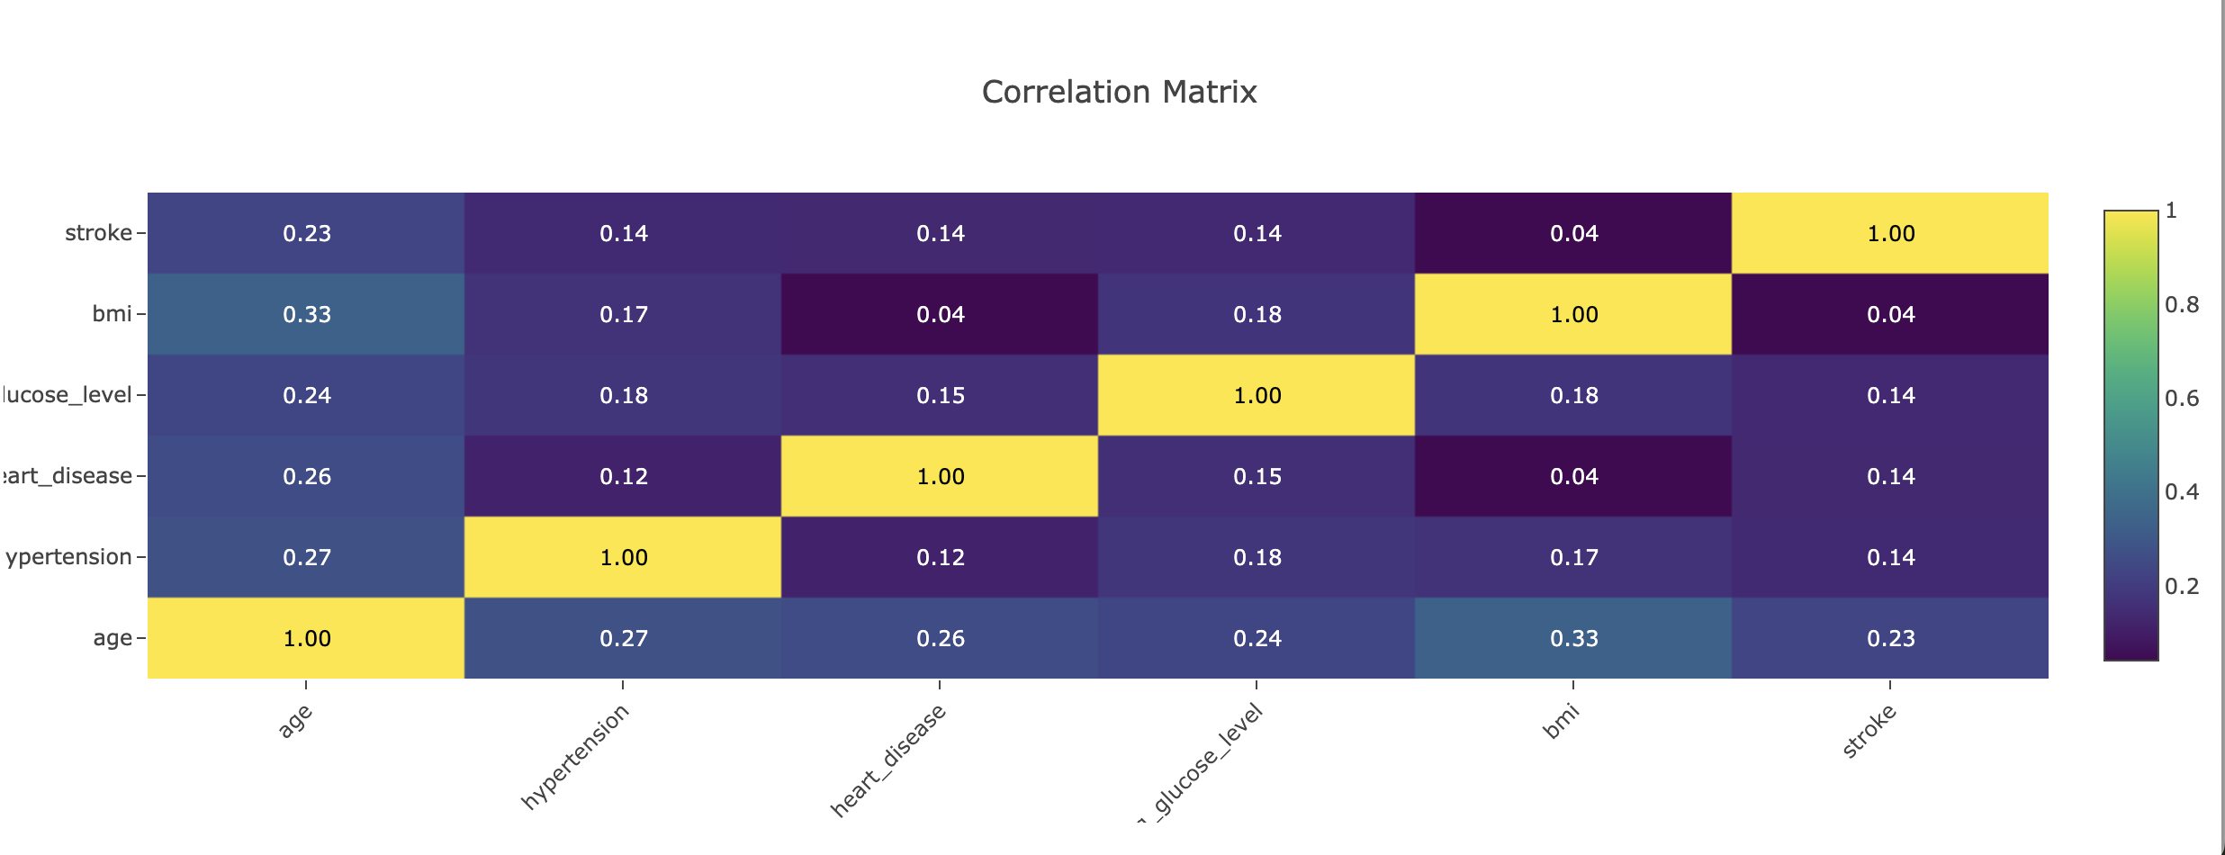
Correlation heatmap
Shows visualization of the correlation between all pairs of features in the dataset.
We examine the correlation with the target variable stoke
The age shows highest positive correlation with the stroke target variable. This suggest that older people might be at the higher risk of having a stroke.

Slide 10
Q2:How does the distribution of strokes vary across different work/residence types and marital statuses
Analysis Approach
Hypothesis:
Individuals working in high-stress environments, such as private and self-employed sectors, will have a higher incidence of strokes compared to those in less stressful jobs like government jobs or being unemployed.
Urban residents will have a higher proportion of strokes due to lifestyle factors and stress associated with urban living.
Marital status will influence stroke occurrence, with married individuals potentially experiencing higher stress levels related to family and financial responsibilities, leading to a higher incidence of strokes.
Libraries:
To conduct this particular analysis, we will use a combination of python libraries for data manipulation, visualization, and statistical analysis. Specifically, we will use: Pandas (manipulation and cleaning), Seaborn and Matplotlib (visualizing the data), and Plotly (creating interactive heatmaps).

Slide 11
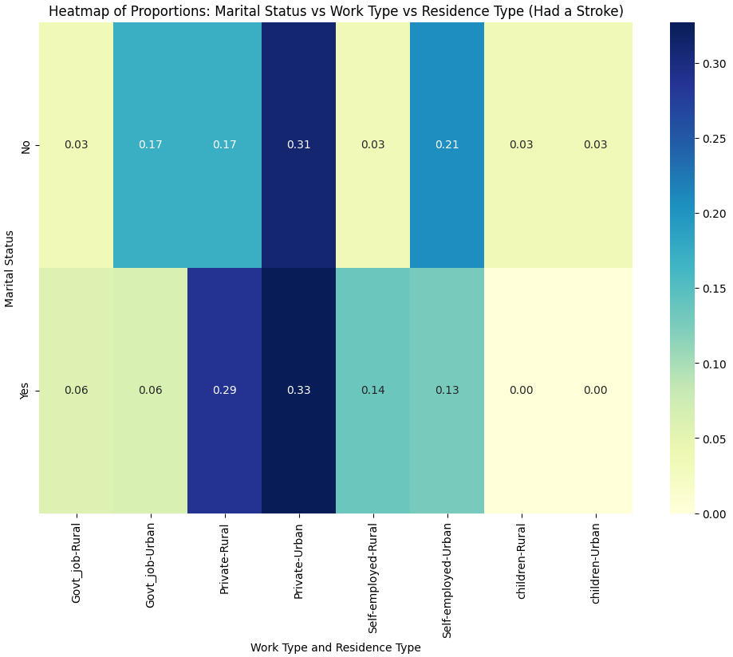
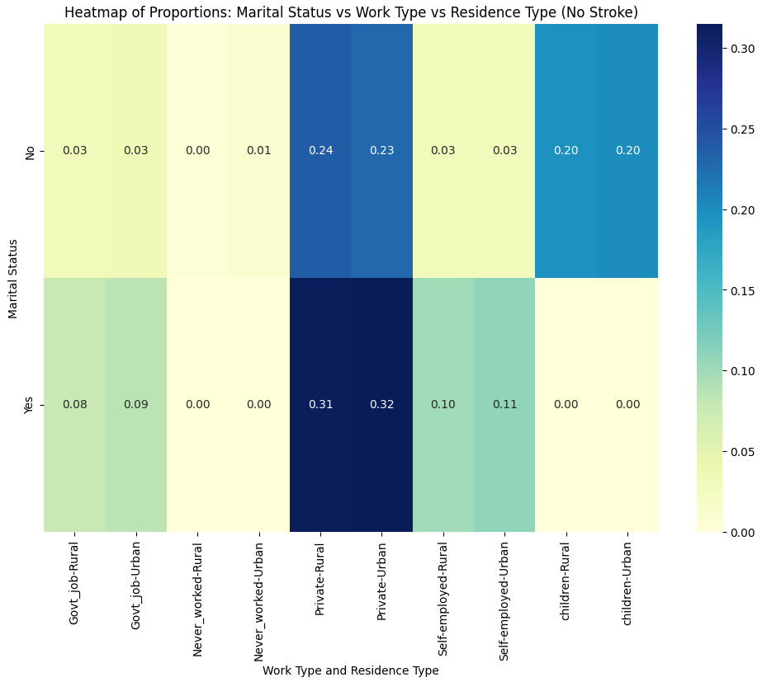
Q2: ..Continued
Visualization

Slide 12

Q3: Biological Predictors of stroke
Analysis Approach
Visualization
Question asked:
How can medical comorbidities, often a larger stressor in patient lives, have a combined and individual effect and/or correlation with instances of stroke?
Hypothesis Considered: High stressors such as Diabetes and Obesity will be more common in stroke patients
Cohorts Considered: Diabetes, Obesity, smoking status
Swarm Plot
Bar Graphs
KDE Diagrams

Slide 13
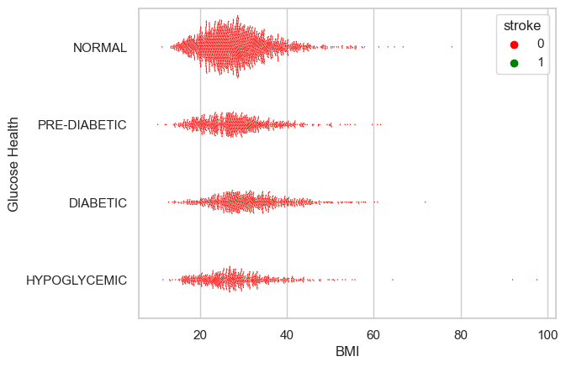
Distribution effects
Visualization Type:
Swarm Plot
BMI has a large effect particularly when considered as a comorbidity
Glucose Level Ranges Considered:
< 70 mg/dL | Hypoglycemia
70 mg/dL – 100 mg/dL | Normal
100 mg/dL – 125 mg/dL | Monitor
> 125 mg/dL | Diabetic

Slide 14
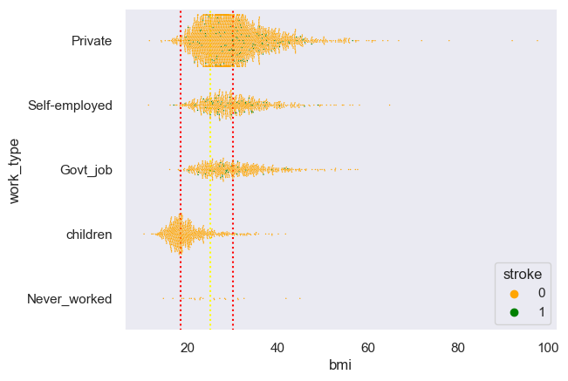
Distribution effects
Visualization Type:
Swarm Plot
Work type displays considerable effect in both stroke incidences and BMI
BMI effect observed
BMI Ranges Considered:
< 18.5 | Underweight
18.5 – 24.9 | Healthy Weight
25.0 – 29.9 | Overweight
> 30 | Obesity

Slide 15
Discussion & Conclusion
Future direction
Limitations
---------------------------------------
Please navigate to the Dashboard Link:

Slide 16


Thank you

